Slide 1
OPS4 in depth
Open Publish Subscribe (v4)
(Communication Middleware)

Slide 2
OPS4, Open Source
Link to GitHub
https://github.com/staxgr/ops (original, outdated)
https://github.com/LelleAnd/ops (current development)
Notes:
Repo structure?
How to build?

Slide 3
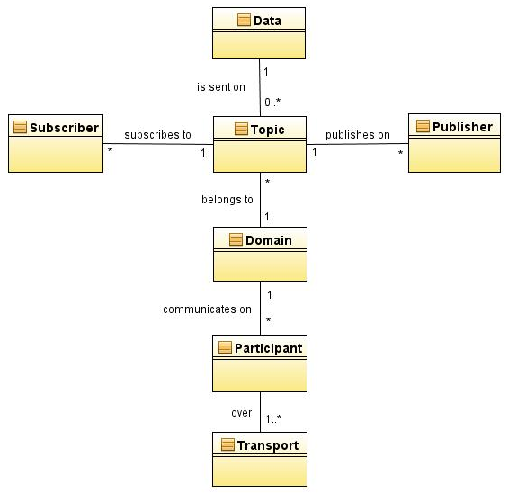
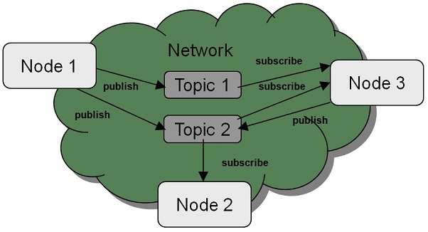
OPS4, Entities
Entities
Data Object (data type)
Topic (variable name)
Domain
Participant
Publisher
Subscriber

Slide 4
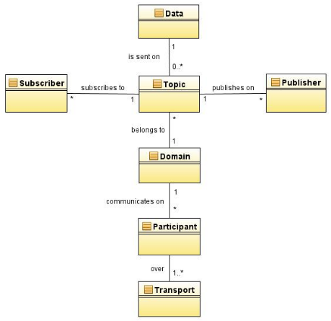
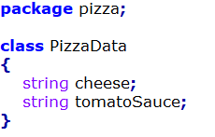
OPS4, Data Objects
Each Data Object is defined in an IDL-file
Namespace: pizza
Filename: PizzaData.idl
Data Object: PizzaData
Data members:

Slide 5
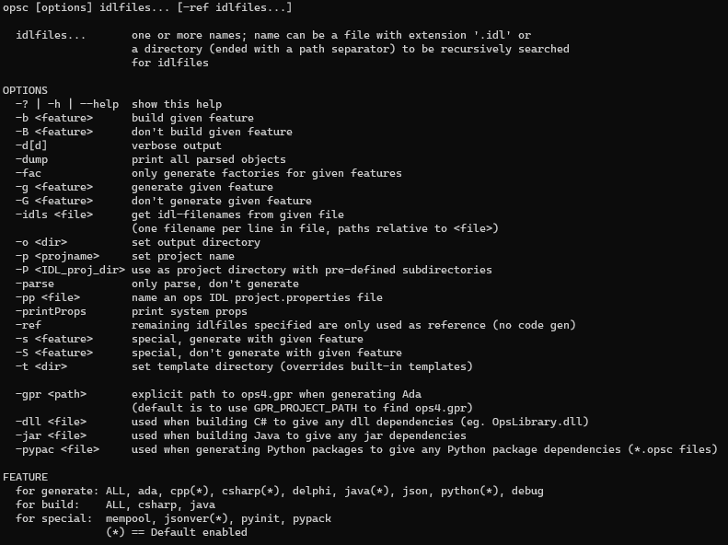
OPS4, Data Objects
opsc command-line tool
Translates IDLs to source code
Data classes
Data members
Serialization & De-serialization
Cloning
Publishers & Subscribers
Class factory
One per project
Creates data class from type name
Ada, C++, C#, Delphi, Java, Python
Can build C# dll’s, Java jar’s and Python packages

Slide 6
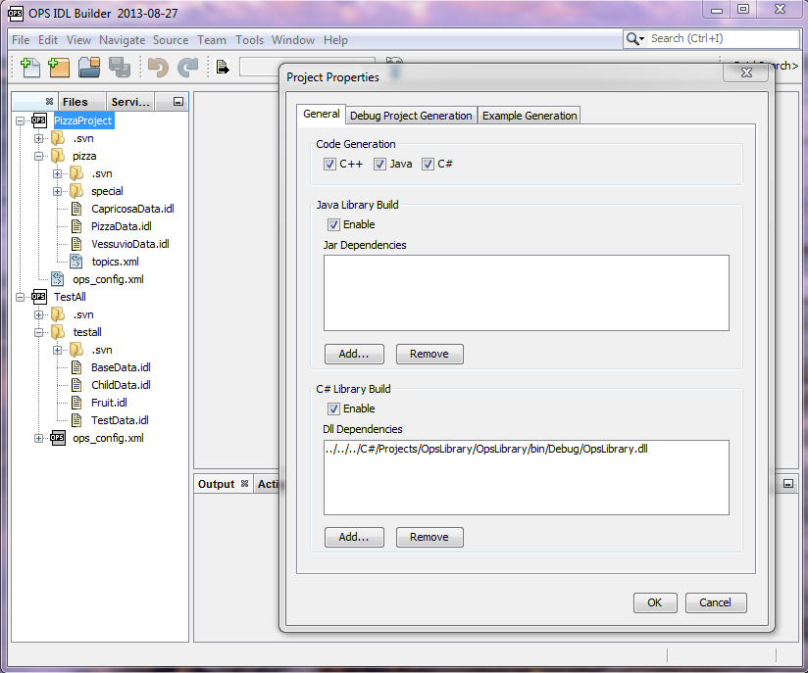
OPS4, Data Objects
OPS IDL Builder tool (outdated)
IDL-files grouped into IDL-projects
Project properties
Translates IDLs to source code
Data classes
Data members
Serialization & De-serialization
Publishers & Subscribers
Class factory
One per project
Creates data class from type name
Can build C# dll’s and Java jar’s
Notes:
OLD, Tool need updates,
Add all languages to dialog
Python, Ada, Delphi, JSON

Slide 7
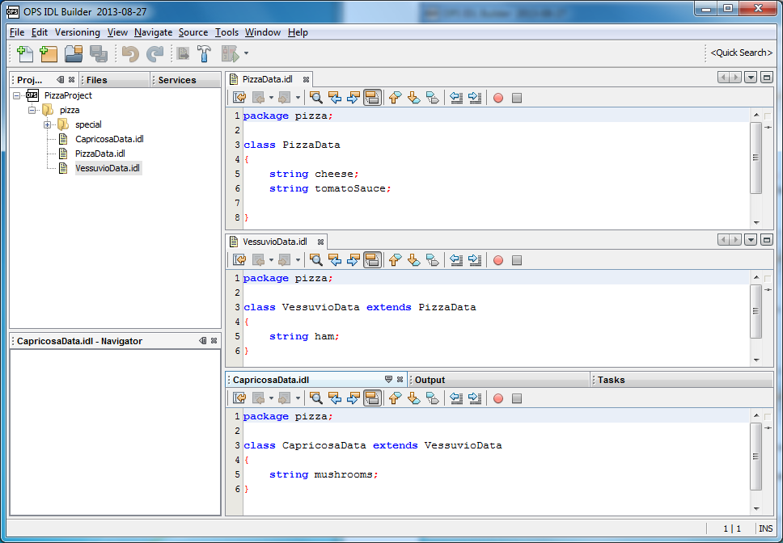
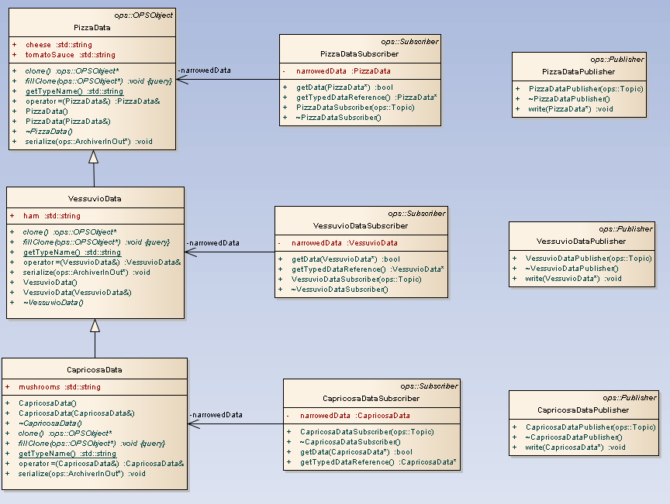
OPS4, Data Objects
Inheritance supported for Data classes
Notes:
Note that OpsObject is the base class

Slide 8
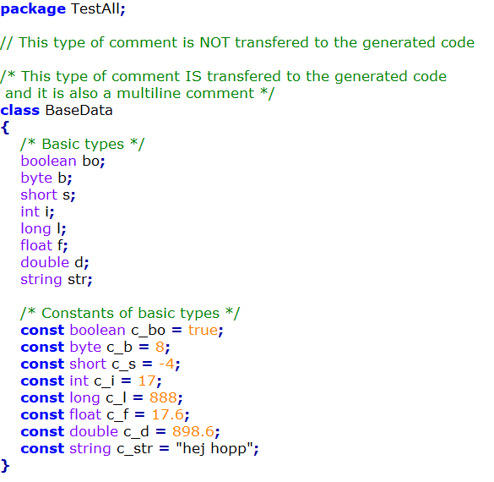
OPS4, Data Objects
Two types of comments
// →IDL-only
/* */ →Copied to generated files
Data types
Basic types
…
Constants of Basic types
Notes:
Constants (added 2019)

Slide 9
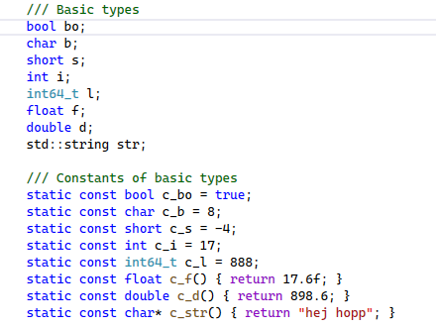
OPS4, Data Objects
Generated C++ (code snippet)

Slide 10
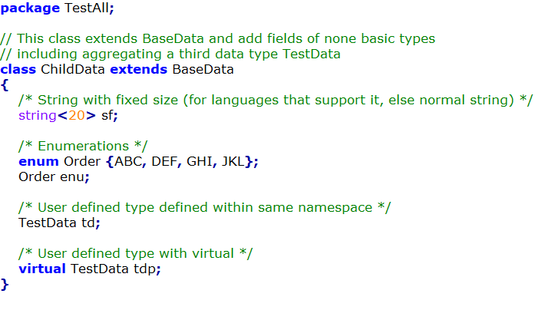
OPS4, Data Objects
Data types
Basic types
Fixed size strings
Enumerations
User defined types
”virtual” specifier
Notes:
Enumerated types (added 2019)
Virtual and non-virtual Data Objects:
Non-virtual → static object
virtual → may ref. any object that inherits from specified base object

Slide 11
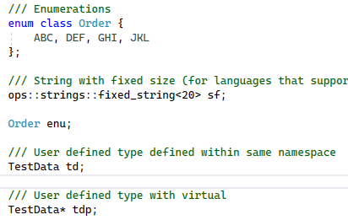
OPS4, Data Objects
Generated C++ (code snippet)
Notes:
Enumerated types (added 2019)
Virtual and non-virtual Data Objects:
Non-virtual → static object
virtual → may ref. any object that inherits from specified base object

Slide 12
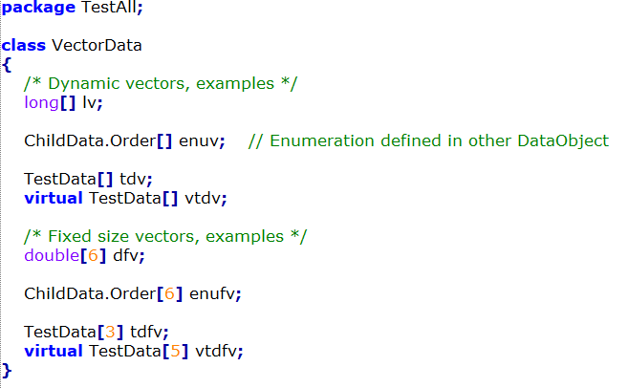
OPS4, Data Objects
Data types
Basic types
Fixed size strings
Enumerations
User defined types
”virtual” specifier
Vectors of the above types
Dynamic
Fixed sized
Notes:
Vectors with virtual can contain any object that inherits from the base object
Directives…

Slide 13
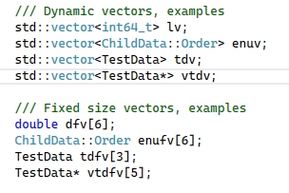
OPS4, Data Objects
Generated C++ (code snippet)
Notes:
Vectors with virtual can contain any object that inherits from the base object
Directives…

Slide 14
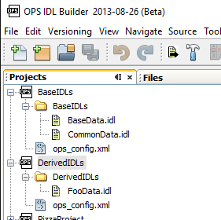
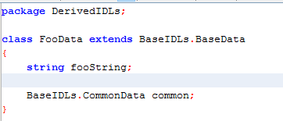
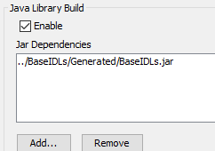
OPS4, Data Objects
Multiple IDL-projects
Notes:
Separate compilations for each project
Can use Data Objects (classes) from other projects (not enum-types)
If C#-dll, Java-jar or Python-packages should be built, the dependencies need to be provided.
One factory is generated for each compilation.

Slide 15
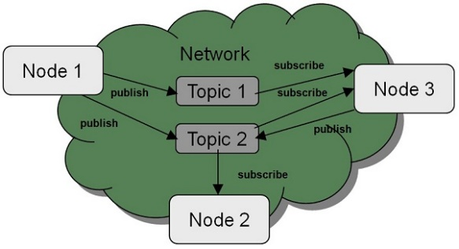
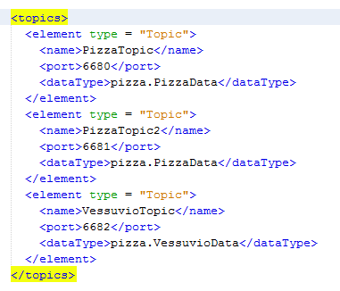
OPS4, Topic
A Topic connects a Name to a Data Object
A Topic defines some transport parameters
A Topic can be seen as a ”communication channel” for a specific Data Object
The Name of a topic is used by the user when setting up Publishers and Subscribers
Available Topics are defined in one or more configuration files
(more about configuration later)
Notes:
PORT can be configured in several different ways

Slide 16
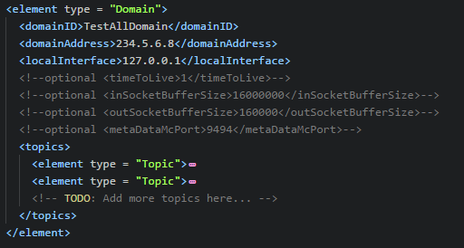
OPS4, Domain
A Domain groups a number of Topics into a logical unit
A Topic can only belong to ONE Domain
A Domain also defines some transport parameters
Domains are defined in one or more configuration files
(more about configuration later)
A Domain has a Name that is unique in its configuration file
The Name of a domain is used by the user when setting up Participants

Slide 17
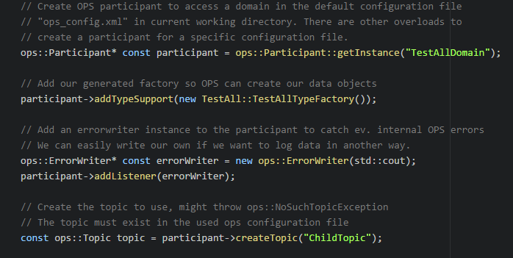
OPS4, Participant
The Participant ...
is the application manager for the communication within a Domain
owns all send and receive data handlers for communication channels (internal classes)
owns the Data Object factories
Generated class factories should be added by user code (needed for objects that are received)
is a factory for creating Topics
A Topic is needed when creating Publishers and Subscribers (Topic Name is used)
can distribute communication meta data
Available subscribers and publishers, …

Slide 18
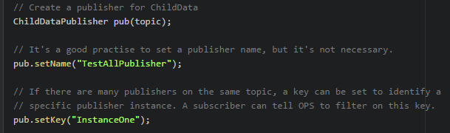
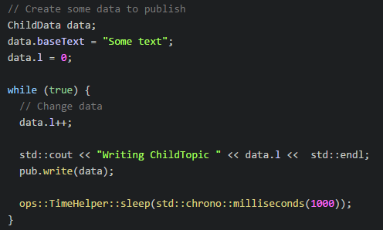
OPS4, Publisher
Publishers are generated
Topics from the Participant
Publisher Name and Key
Meta data sent to subscribers
Publishing Data
Have an instance of the Data Object
Update members in the Data Object
Call write()
Notes:
Start()
Stop()

Slide 19
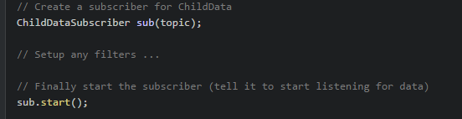
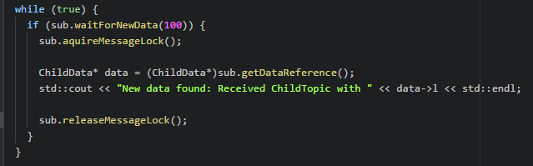
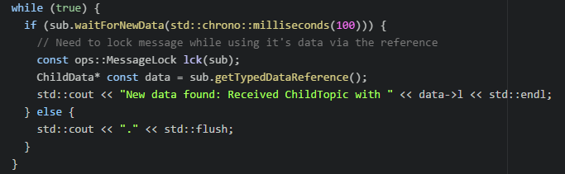
OPS4, Subscriber
Subscribers are generated
Topics from the Participant
Receive filters
Key filter
Time based filter
User defined filter on any meta data and/or member field in the Data Object
Receiving can be
Based on polling or
Event-based using callbacks
Notes:
Point out the LOCK. Without locking, data can be changed while accessing it.
Several different calls, some takes the LOCK and makes a copy.
The LOCK blocks all reception in the participant (C++) while held.
Point out the RAII helper for the LOCK (ops::MessageLock).
Polling: If messages arrive close together, they can easily be missed. Only the latest is saved in the Subscriber.
Advanced: C++ and Delphi implements a history buffer with adjutstable size, but it is difficult to use correct. Easier to use callbacks.
Ada also have some code for a history buffer, but it is not fully implemented yet.

Slide 20
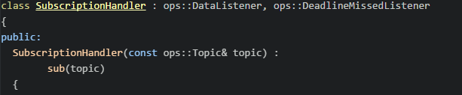
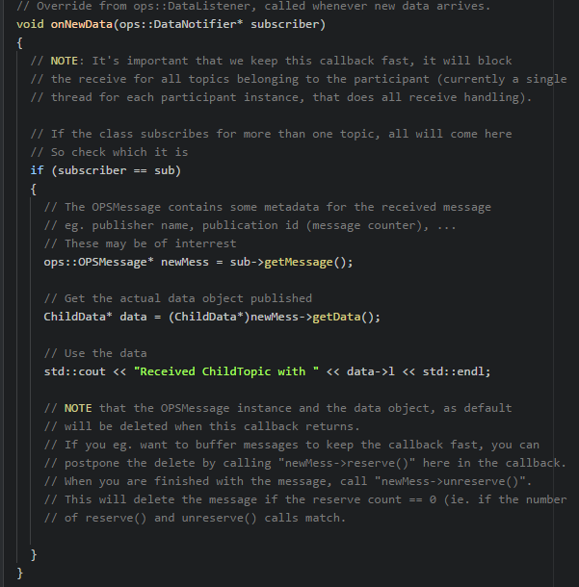
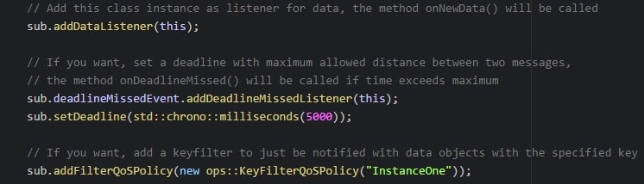
OPS4, Subscriber, Callback example
OPSMessage
Metadata
Publishername, Topicname, IP, Port, PublicationID
Metods
reserve() / unreserve()
Notes:
Point out that objects are removed as soon as the callbacken returns.
OPSMessage contra OPSObject

Slide 21
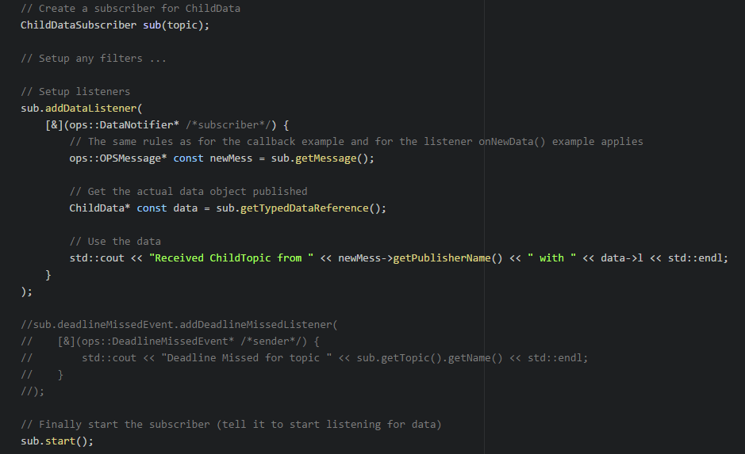
OPS4, Subscriber, Lamda example
Notes:
Point out that objects are removed as soon as the callbacken returns.

Slide 22
OPS4, Transport
All transports are socket based
Multicast many to many
+ Load on publisher not affected by adding subscribers
- Based on UDP were packets can be lost (for C++, ACK and resends can be used)
- Small HW may not always support multicast
- Sent to all nodes on subnet (smart switches can be used to block, IGMP snooping)
UDP many to many, many to one
+ Only sent to configured nodes
- Packets can be lost
- Load on publisher increases for each subscriber
TCP many to many, one to many
+ Only sent to configured nodes
+ No packets are lost
- Setting up TCP-link takes some time
- Load on publisher (server) increases for each subscriber (client)
- Slowest subscriber will limit the publishing rate (when buffers are filled)
Notes:
UDP/TCP many-to-many requires metadata to be used
Metadata always use multicast

Slide 23
OPS4, Participant
Receive data handler implementation details
C++
One common thread for all communication channels (sockets) in a participant
The thread reads all sockets, de-serializes data, creates the objects and gives them to the subscribers
To improve receive performance (i.e. use more CPU cores), use several participants and topics on different ports
C#, Java, Delphi, Ada and Python
One unique thread for each communication channel (socket)
Each thread reads a socket, de-serializes data, creates the objects and gives them to the subscribers
To improve receive performance (i.e. use more CPU cores), use topics on different ports
Notes:
Can use multiple participants

Slide 24
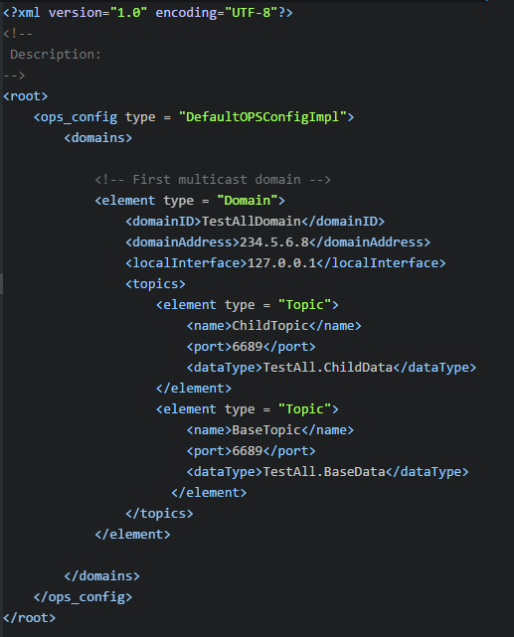
OPS4, Configuration (minimal)
XML-file with one or more Domains, each with one or more Topics
Domain parameters
domainID
domainAddress
Multicast address (224.x.x.x – 239.x.x.x)
localInterface
E.g. 127.0.0.1, 192.168.10.0/24, …
List of Topics
name
Must be unique within Domain
dataType
port
Notes:
Minimal configuration
Add something about OpsConfigRepository, to make it easier to use multiple config-files (currently missing for Python)

Slide 25
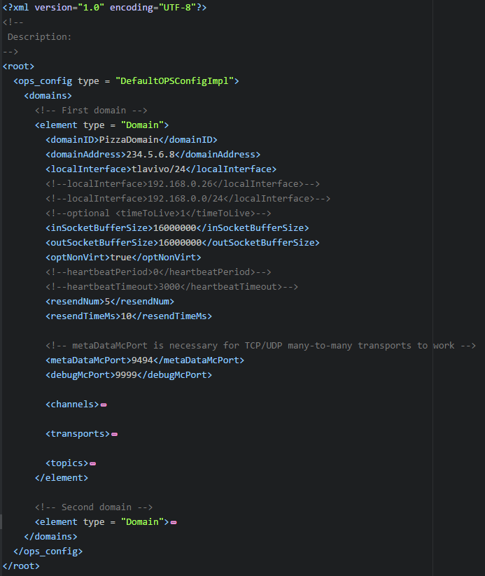
OPS4, Configuration (full)
Domains
Parameters
See repo doc
Channels
Transports
Topics
https://github.com/LelleAnd/ops/blob/development/Doc/OpsConfig.md
Notes:
Different ports, same ports
Socket buffers

Slide 26
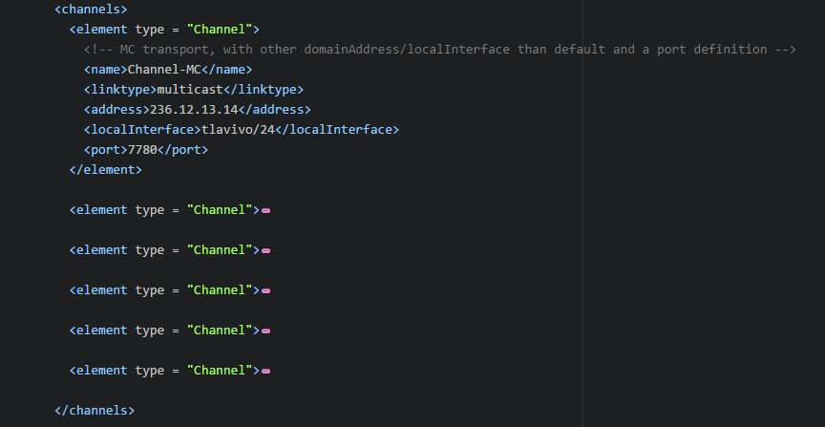
OPS4, Configuration (full)
Domains
Parameters
Channels
Parameters
See repo doc
Transports
Topics
https://github.com/LelleAnd/ops/blob/development/Doc/OpsConfig.md
Notes:
Different ports, same ports
Socket buffers

Slide 27
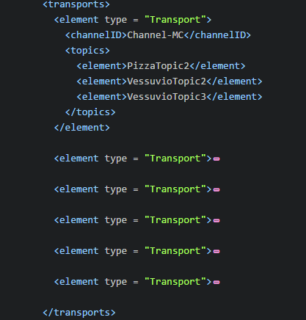
OPS4, Configuration (full)
Domains
Parameters
Channels
Transports
Parameters
See repo doc
Topics
https://github.com/LelleAnd/ops/blob/development/Doc/OpsConfig.md
Notes:
Different ports, same ports
Socket buffers

Slide 28
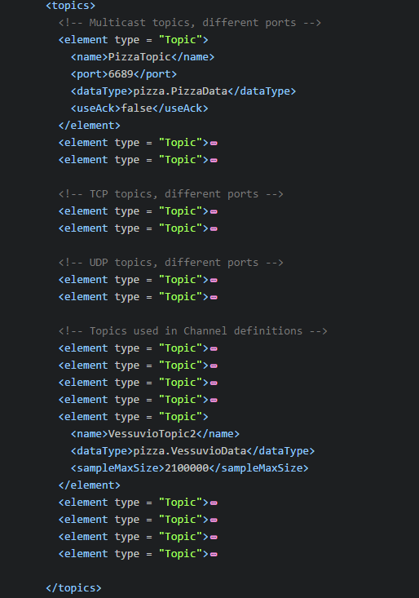
OPS4, Configuration (full)
Domains
Parameters
Channels
Transports
Topics
Parameters
See repo doc
https://github.com/LelleAnd/ops/blob/development/Doc/OpsConfig.md
Notes:
Different ports, same ports
Socket buffers

Slide 29
OPS4, Large Data Objects
Large data objects (> 60000 bytes)
Only one publisher
Topic must have a unique communication channel (socket port)
https://github.com/LelleAnd/ops/blob/development/Doc/LargeMessages.md
Drawbacks with large objects
Multicast & UDP transports
One lost Ethernet packet, loses the whole Data Object
→ important to have good HW and enough memory for Ethernet buffers
41
Ethernet
Packets
Data Object
UDP Packets
60000
1472
…
60000
…
1472
60000
1120
Notes:
DISCUSSION: Large data on same or separate topics
Jumbo packets

Slide 30
OPS4, Memory Management
Memory management
Ref. counting
OPSMessage methods reserve() / unreserve()
https://github.com/LelleAnd/ops/blob/development/Doc/AdvancedReferenceHandling.md
…
Notes:
OPSMessage

Slide 31
OPS4, Version Handling
Using Data Object inheritance for version handling…
A change to an existing Data Object results in a need for total rebuild of all programs depending on it or failures will occur when mixing old an new.
Instead one can,
create a new Data Object that inherits from the old Data Object,
add the new fields to the new object,
update the publisher that have the new parameters, but it must still also provide the old values,
update the subscriber(s) that need the new parameters,
all other publishers and subscribers can be left as is.
See repo doc for other alternatives https://github.com/LelleAnd/ops/blob/development/Doc/VersionHandling.md

Slide 32
OPS4, Binary Protocol
See repo doc https://github.com/LelleAnd/ops/blob/development/Doc/Protocol.md

Slide 33
OPS4, Advanced
DebugConsole
…

Slide 34
OPS4 Artifact usage
Idl grammar spec
javacc
Generated Java code
Idl
definitions
Hand
Coded Java
javac
opsc
Application
Idl
definitions
Generated
Language
specific
code
Application
code
Languages:
Ada, C++, C#, Delphi, Java, Python
(JSON)
OPS
Language
specific
code
Lang.
Compiler
Executable

